Slide 1
5DH Security Access
Diagnostics Hardening using SaSrv

Slide 2
Diagnostics Hardening using SaSrv

Slide 3
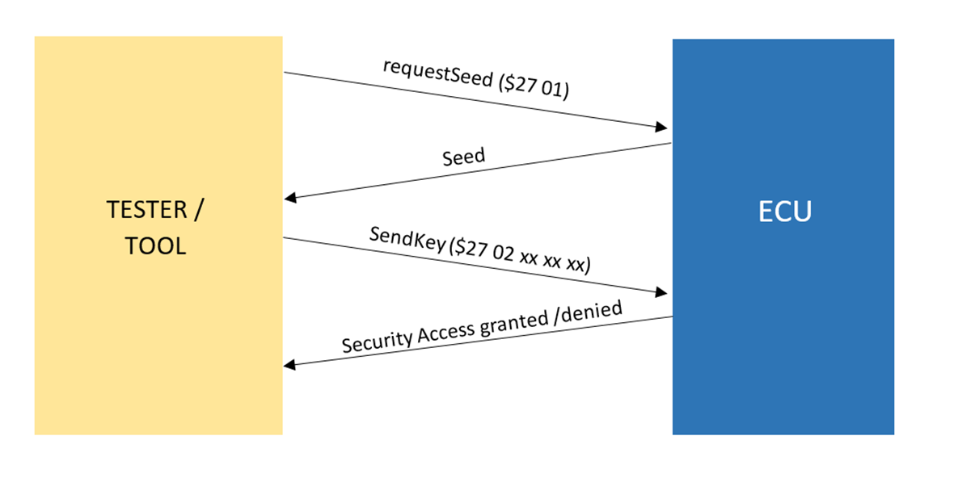
Security Access($27)
1.
Tester/Tool requests seed from the ECU by Service $27 – Security access and sub function – 01 .
2.
ECU replies back with a 256 byte Security seed.
3.
Tester/Tool has to generate 256 byte key and has to send to the ECU using sendKey($27 02) service.
4.
ECU validates the Key and sends positive or negative response.

Slide 4
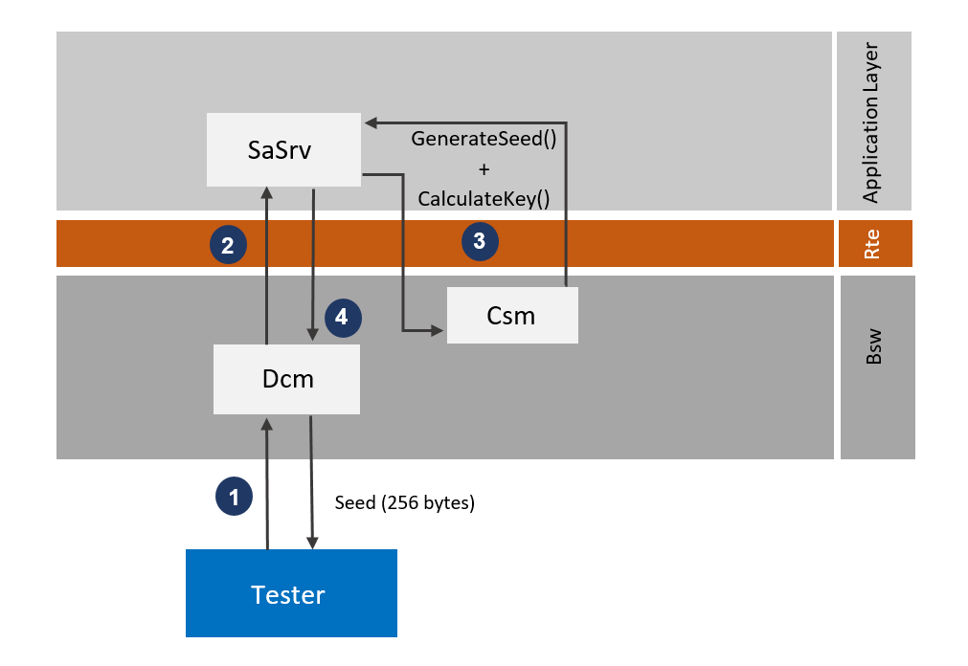
Request Seed - $27 01
Tester requests seed with SID 27 and sub function 01
Dcm validates the request from the tester. If the service exists dcm forwards the request to SaSrv SWC. If the service does not exist dcm replies with NRC 11.
SaSrv generates 256 byte seed and Key with the help of Csm jobs.
SaSrv sends 256 bytes seed to dcm module which sends it to the tester

Slide 5
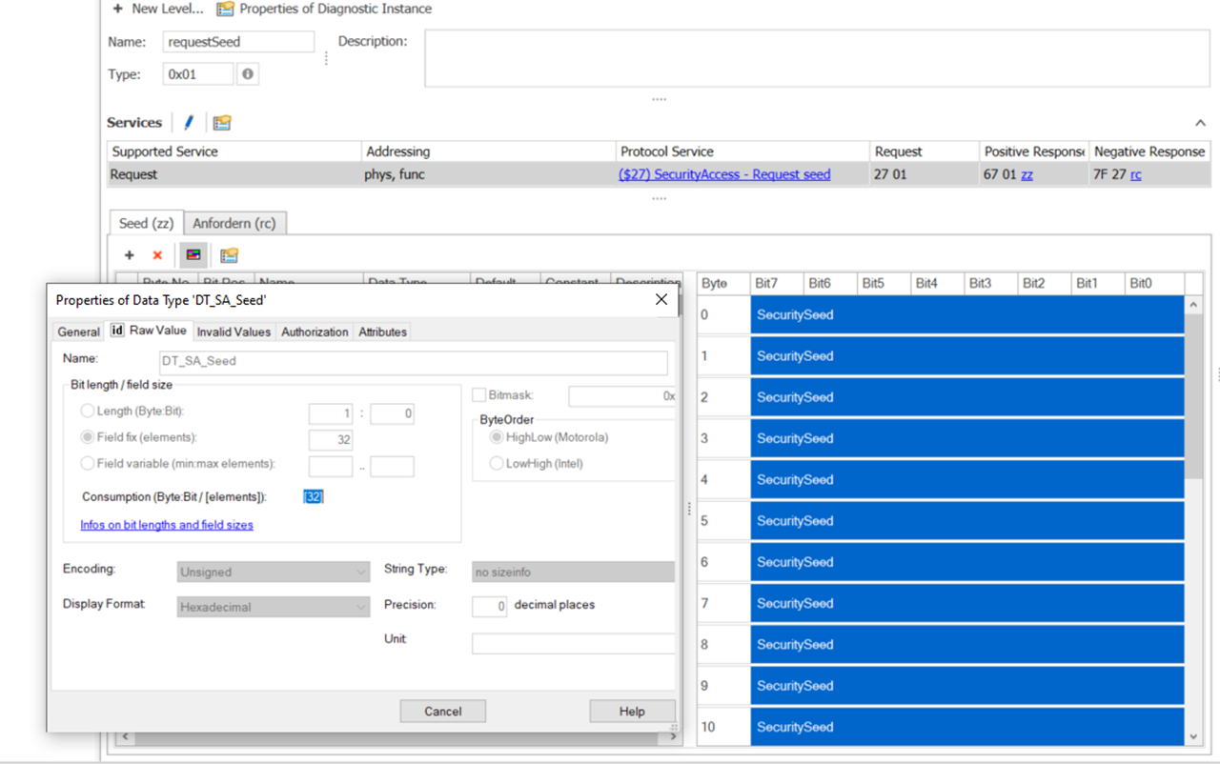
Seed size
According to CDD – 32 byte

Slide 6
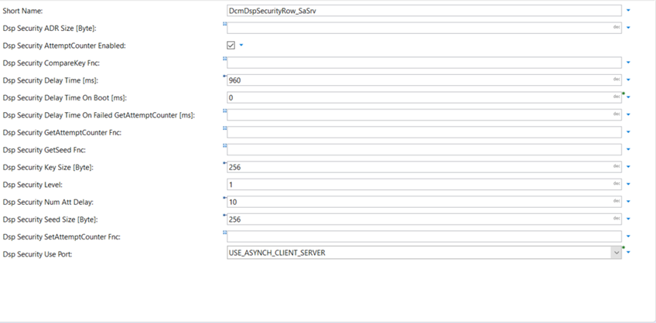
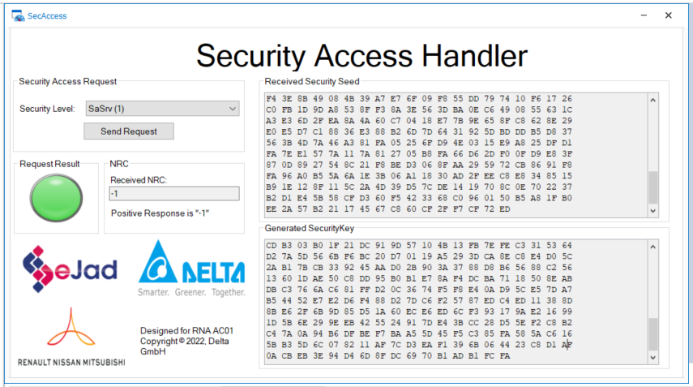
According to configurator and Security access handler – 256 byte

Slide 7
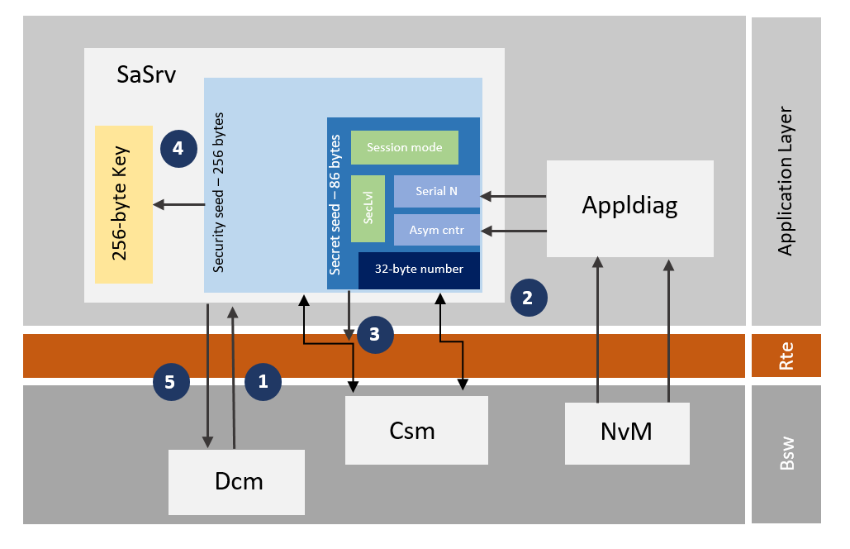
SaSrv
1
Dcm send request for seed to SaSrv SWC.
2
SaSrv computes a Secret seed of 86 byte which consists of 32 byte random number generated using Csm job(RNG), ECU serial number and Asym counter from NvM, security level and Session mode
SaSrv generates a security seed with the secret seed using RSAES_OAP algorithm from Csm stack to give a 256 byte Security seed.
3
4
5
SaSrv computes a 256 byte Key using the Security Seed generated
Sends the Generated 256 byte seed to Dcm to the tester.

Slide 8
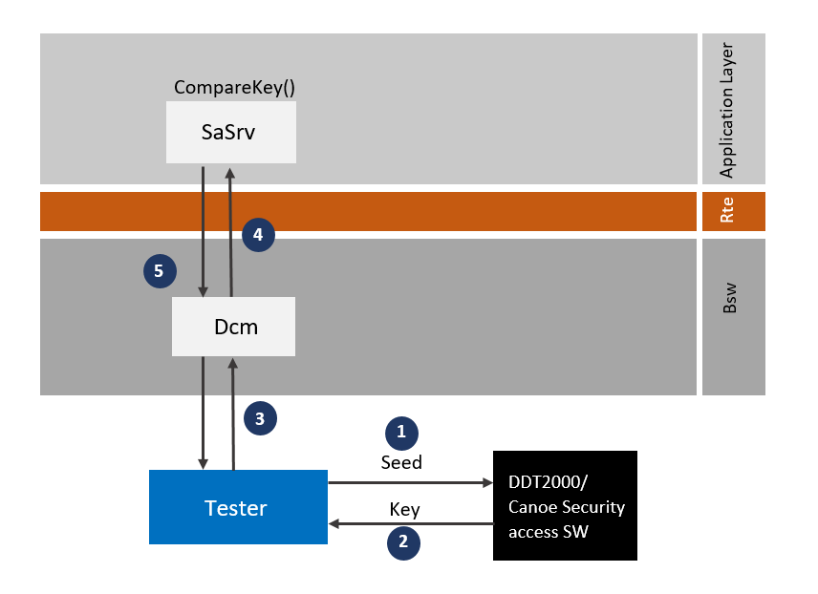
Send Key - $27 01
Tester sends 256 bytes seed to DDT2000/Security access Handler.
DDT2000/Security access Handler calculates 256 bytes key and sends back to tester.
Tester send the key along with SID 27(Security Access) and sub function 02(sendKey) to dcm.
For e.g. : 27 02 xx xx xx xx
Dcm validates the request and sends to SaSrv SWC
SaSrv compares the Key from dcm with the key that is already calculated. Gives access with positive response if the key matches and negative response if key does not match.

Slide 9
Smarter. Greener. Together.

